Slide 1
RTO 12 REGION
MAP PROJECT
DAVID STEWART - Manager

Slide 2
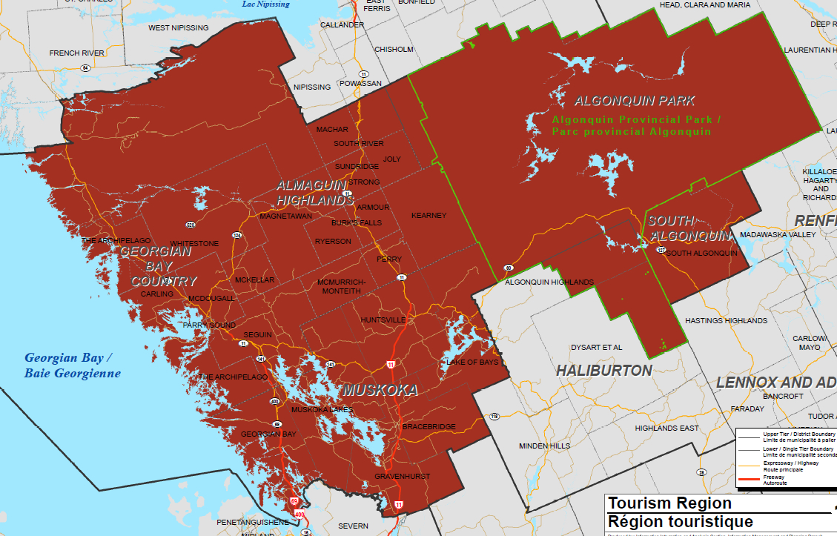
RTO 12 REGION
MAP PROJECT
DAVID STEWART - Manager

Slide 3
ARE YOU ON THE MAP
The tourism visitor wants access to available services, shopping and events in the area.
Most tourism visitors are now wired with personal communication devices.
Therefore. Today and in the future, all businesses are part of tourism

Slide 4
HOW CAN YOU GET ON THE MAP?
Visit Google Places
Create an account
Fill out the information forms
Enjoy. You are now on the map and visitors to the area will find you quickly.

Slide 5
How Can the RTO Help
Set up Training and Education Sessions around the region for those that need it.
Provide a qualified instructor in SEO Techniques to guide you through the forms to make sure you enter the proper information.
Create a data base of members and keep everyone up to date on any opportunities to improve their map pages

Slide 6
RTO 12 REGION
MAP PROJECT
DAVID STEWART - Manager

Slide 7
RTO 12 REGION
MAP PROJECT
DAVID STEWART - Manager

